Slide 1


SMART INDIA HACKATHON 2024
Problem Statement ID – SIH1678
Problem Statement Title- RE-DACT
Theme- Blockchain & Cybersecurity
PS Category- Software
Team ID- 36797
Team Name- Diplomats

Slide 2
Diplomats
Time Block | Activities and Focus Areas
0-1 Hours | Planning and setup: Assign roles, set up tools (Python, Tauri, Android Studio), repo creation.
1-2 Hours | Backend NLP: Implement basic NER (SpaCy) for redaction of sensitive data (names, dates, etc.).
2-3 Hours | Gradational redaction: Design sensitivity scale (0-100%), test on text/CSV data.
3-5 Hours | Tauri desktop: Basic UI (file upload, redaction slider), integrate backend for file processing.
5-7 Hours | Android app: Develop basic UI, integrate with backend (Flask/FastAPI for file handling).
7-10 Hours | Backend advanced: Add PDF redaction, image OCR (Tesseract), and enhanced output formats.
10-12 Hours | Tauri advanced: UI/UX improvements (progress bars, themes), multi-format support (PDF/images).
12-15 Hours | Android advanced: UI/UX enhancements, support for multiple file types, performance testing.
15-18 Hours | Synthetic data: Develop module for replacing sensitive info with synthetic values.
18-22 Hours | Error handling & security: Robust error handling, data encryption, auto-delete temp files.
22-26 Hours | Performance tuning: Optimize Python scripts (multiprocessing) and app performance.
26-30 Hours | Deployment: Package Tauri app for desktop, generate APK for Android, initial testing.
30-33 Hours | Final touches: Comprehensive testing, debugging, and presentation preparation.

Slide 3
Performance Measure
Diplomats
Efficiency:Efficiency is depends on how fast our system reacts
formula:size/speed
Precision:Proportion of correctly redacted sensitive data (True Positives / Predicted Positives)
formula:TP/TP+FP
The precision of our project is 93%
Recall:Proportion of all sensitive data that was correctly (True Positives / Actual Positives)
formula:TP/TP+FN
The Recall Matrix of our project is 90%
F1 Score:Harmonic mean of Precision and Recall, balancing both.
formula:2*Precision*Recall/Precision+Recall

Slide 4
RoadMap
Diplomats
Phase 1: Project Foundation and Research (Completed or In Progress)
Phase 2: Development of Core Features
Phase 3: Advanced Features and Optimization
Phase 4: Security and Compliance Validation
Phase 5: User Feedback
Phase 6: Full Release and Maintenance
Phase 7: Future Expansion

Slide 5
Figma
Diplomats
https://www.figma.com/design/U9pu9EpRB0a5nNjz4sJSYr/Untitled?node-id=6-4143&node-type=frame&t=OagxvcQd8EzuU2F9-0

Slide 6
Future Scope
Diplomats
Real-Time Audio and Video Redaction
Expanding redaction capabilities to not just text but also sensitive data in audio and video files, such as faces, voices, or location-based information, using AI models for speech and image recognition.
Self-Learning AI Redaction Models
Developing machine learning models that learn from user interactions and feedback to continuously improve redaction accuracy, ensuring that new types of sensitive data are effectively redacted over time.
Decentralized Redaction with Edge Computing
Implementing edge computing to process redactions locally on devices (like smartphones or IoT devices), ensuring sensitive data never leaves the device and enhancing privacy.
Synthetic data replacement using GenAI
Generate realistic synthetic data to replace sensitive or missing information while preserving structural integrity.
Corrupted file detection system
Identify and flag corrupted files using advanced algorithms for seamless data handling.

Slide 7
Functional Requirements
Diplomats
1.Sensitive Data Detection:
Automatically identify sensitive information (e.g., names, addresses, credit card numbers, medical terms) using NLP and machine learning.
2.Redaction Levels:
Offer a gradational redaction scale.
3.Multi-Format Support:
Process and redact text documents (e.g., Word).
Handle PDFs, images, and scanned documents with OCR integration.
4.Security and Encryption:
Encrypt all data during processing and storage.
Ensure no sensitive data is stored post-processing.
5.Performance and Scalability:
Efficiently handle large datasets (>100MB files) without significant delays.

Slide 8
Relevance
Diplomats
1. Ensuring Data Privacy and Security
Redaction helps safeguard sensitive information such as personal data, financial records, and confidential business information, ensuring compliance with data privacy regulations like GDPR, HIPAA, and CCPA.
2. Compliance with Legal and Regulatory Requirements
Many industries (e.g., healthcare, finance, legal) are required by law to protect sensitive data. Redaction ensures adherence to privacy laws and avoids penalties or lawsuits.
3. Protecting Intellectual Property (IP)
Businesses use redaction to safeguard proprietary information in contracts, research papers, and patents before sharing documents externally.
4. Facilitating Secure Information Sharing
Redaction enables organizations to share documents securely by ensuring that only non-sensitive, relevant data is made available to recipients.
5. Enhancing Trust and Transparency
By redacting sensitive or irrelevant information, organizations can build trust with stakeholders, demonstrating their commitment to safeguarding data privacy.

Slide 9
Conclusion
Diplomats
RE-DACT is a modern approach based redaction tool designed to ensure data privacy and security through a user-defined gradational redaction scale, offering flexibility from simple anonymization to generating fully synthetic data. It supports diverse input formats like text, images, PDFs, and videos, providing structurally intact, customized outputs while maintaining strict user control over data. With features like real-time redaction, advanced NLP techniques, and secure coding practices, RE-DACT simplifies complex anonymization processes, enhances usability with a seamless interface, and ensures compliance with privacy regulations. This innovative solution empowers users to manage sensitive information effectively, fostering trust, privacy, and scalability.

Slide 10
Check List
Diplomats
✔ Figma ✔ Ui/Ux ✔ Literature Survey ✔ Partial Pdf implementation ✔ docx implementation ✔ Full Pdf implementation ✔ Ppt implementation ✔ log implementation | ✔ images implementation ✔ Video implementation ✔ Integration of the module ✔ OCR(Optical Character Recognition) for images and pdf ✔ Synthetic Data (if possible) ✔ We will be implementing a JWT based login

Slide 11
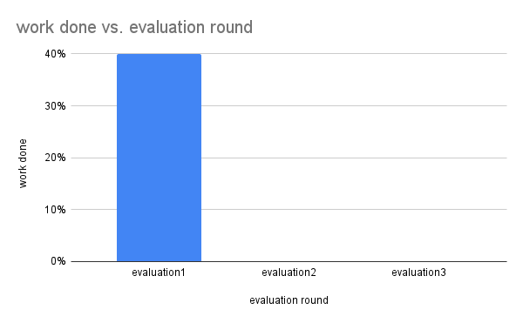
progress summary

